Slide 1

Analyzing & Predicting the pattern of usage of CTA Transportation
Github Repository : https://github.com/uic-cs418/python_demons.git
By Python Demons Group
Faezehossadat Khademi, Github : Faezeh1900 , fkhade2@uic.edu
Vipul Dhariwal, Github : VipulDhariwal, vdhari3@uic.edu
Piyush Agrawal, ‘Github : agrawalpiyush’, pagraw7@uic.edu
Kasturi Joshi, ‘Github: kasturijoshi06’, kjoshi27@uic.edu
Akshat Pancholi, ‘Github : Loanchip’, apanch21@uic.edu

Slide 2
Introduction
CTA is a mass transit in Chicago providing :
But due to the rise in population and movement of commuters
What we have done
Bus services and
Train services
What can CTA do to accommodate the demands of all its commuters and increase the ridership?
Explored how the variation in the commuter travel, location and other factors affects the CTA.
Looked at ways to optimize the CTA transportation and make it prepared for the changes in Commuters’ usage of its services.
Predicted the major changes in ridership to help CTA plan its transportation services efficiently

Slide 3
Outline
Data Cleaning
Insights and Visualizations
Exploratory Data Analysis
Predicting ridership values

Slide 4
Dataset
Daily ridership
Bus dataset
Monthly ridership
CTA Dataset
Daily ridership
Train dataset
Monthly ridership

Slide 5
Data cleaning
Separated Year and Month from Date and added columns for them
Dropped all the NaN & double values
Converted String into Int in of month total column
Adjusted all the values for the leap year
Dropped special routes which did not operate every month of all the years (for Some part of the exploration)
Dropped Unnecessary Columns
Separated columns with multiple entries
Added new column of days by extracting the days
Grouped the dataset on the basis of 4 features such as route, day, year

Slide 6
Exploratory Data Analysis
Granularity
The data is grained in monthly fashion for both the bus as well as train datasets
Data is divided for each bus and each train.

Slide 7
Exploratory Data Analysis
Structure
Tabular form
The data is in the form of CSV files
Bus dataset columns : bus route, route name, average ridership for weekdays, saturday and sundays
Train dataset columns: Train station, month, average weekday, saturday and sunday ridership

Slide 8
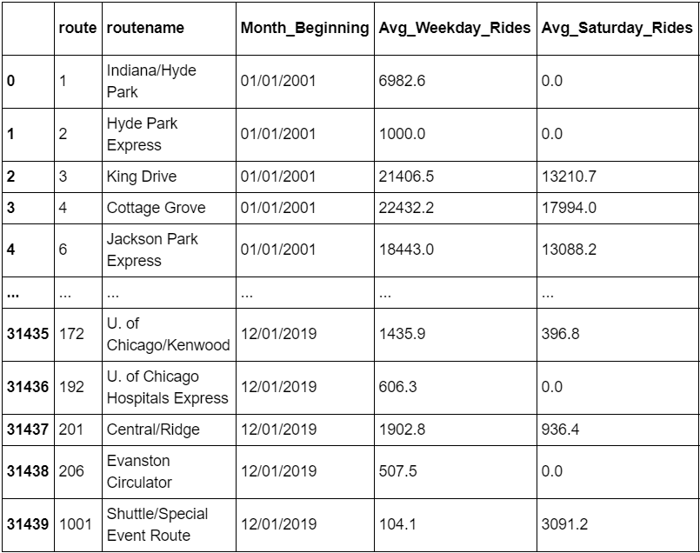
Exploratory Data Analysis
Temporality
The data we have collected ranges from 1st January 2001 to 1st December 2019

Slide 9
Exploratory Data Analysis
Scope
We have complete data with respect to scope.
We filtered some of the columns from both the datasets
Coverage remains the same after filtering

Slide 10
Exploratory Data Analysis
Faithfulness
Though our data is accurate and gives the idea about ridership, it does not capture the reality completely
The ridership is counted while boarding, not unboarding. Assumption: Passenger travelling rides the entire journey of the bus/ train
For trains, count is increased at the station entries. Reality is not captured when a person changes the line internally within a station

Slide 11
Insights
BUS
Drastic change (Increase and Decrease in ridership) in bus routes ['169', '1', '51', '2', '108', '171', '11', '28', '120', '100']
Increase in ridership in the routes from Downtown routes in 2007 - gain in overall ridership
Stopping services for less popular routes in South region in 2009 led to a significant drop in overall ridership
Ridership declined steadily since 2012 due to the emergence of cheaper Uber operations like UberX and Uber Share
Heavy road construction in Downtown - high decrease in ridership in 2016

Slide 12
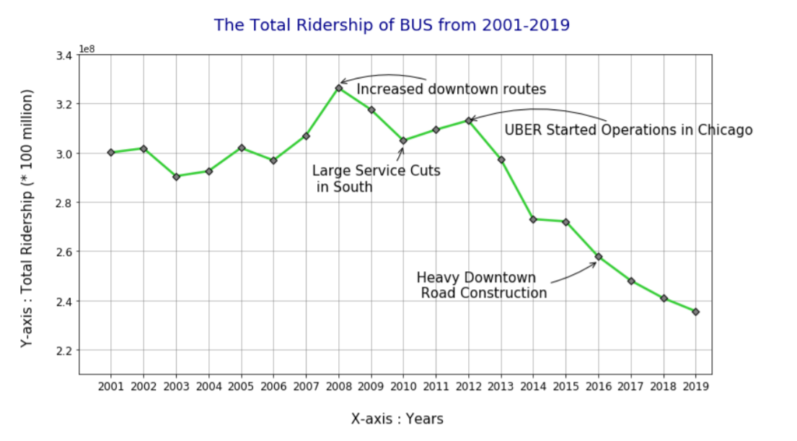

Slide 13
Insights
Hypothesis
In many of the CTA annual reports, it is stated that the bus ridership declined at some points due to decrease in GAS prices.
We tested the correlation between the GAS price and total ridership.
It turned out to be a mere 0.095.
Ridership is not correlated to GAS prices
This hypothesis is taken from the official CTA annual reports : https://www.transitchicago.com/ridership/

Slide 14
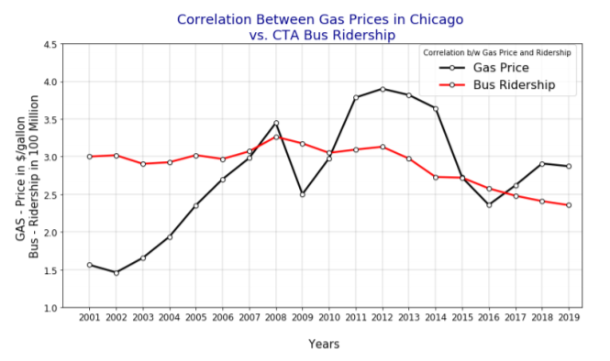
Visualizations

Slide 15
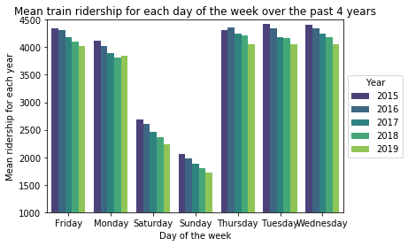
Insights
Train
The CTA train ridership has plummeted not just on weekends due to office holidays but also on weekdays over the past 4 years

Slide 16
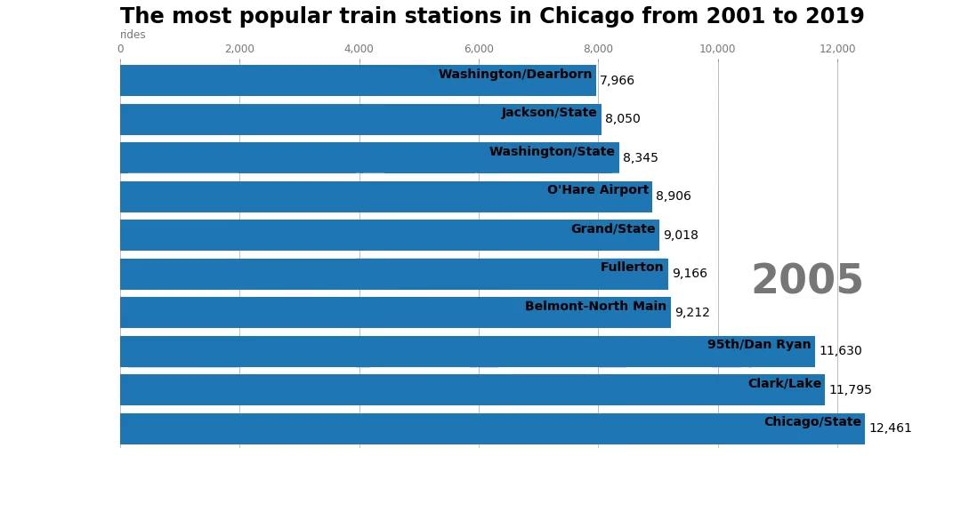
Popular Train Station race

Slide 17
Insights
From the train station race
The southern train station like 95th/Dan Ryan which was the most popular in 2001 is nowhere in the top 10 in 2019
Less popular. Ridership in the 21st century grew in the downtown area - business boom.
Population of Chicago has moved from south to the north.
Stations like Clark/Lake and Lake/state have the highest ridership since the past 10 years.
Boom in the business sector in the loop.
All the 8 train lines run on the stations in the loop area. Whereas for the non-loop stations, only maximum 3 lines pass through a single station.
Opportunity for commuters to move from one line to the other at the same station.

Slide 18
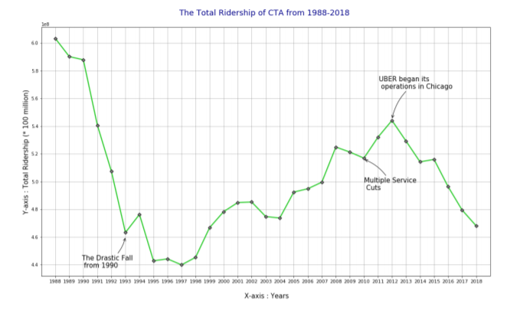
Total CTA ridership (Train and Bus)
We merged the individual datasets provided by CTA to get a complete picture of the variation in overall Ridership in the CTA services

Slide 19
Predicting the ridership of buses using Recurrent Neural Networks
Used Long short-term memory model (LSTM) to predict the bus ridership for the year 2019
This ridership is a discrete integer value
Why LSTM?
One of the best models for extracting patterns in long sequences
The gated architecture of has the ability to manipulate its memory state thus, they are ideal for time-series analysis
Tried support vector regression, linear regression and vector autoregression but they gave a bad accuracy as the features are multivariate time-series features
Huge dataset of 60,000 rows

Slide 20
Bus Ridership Predictions
Pre-processing for LSTM:
Dropped the routes varied drastically- to reduce the noise.
Unstable data Took difference of each month by next month. Obtained stability
Solution

Slide 21
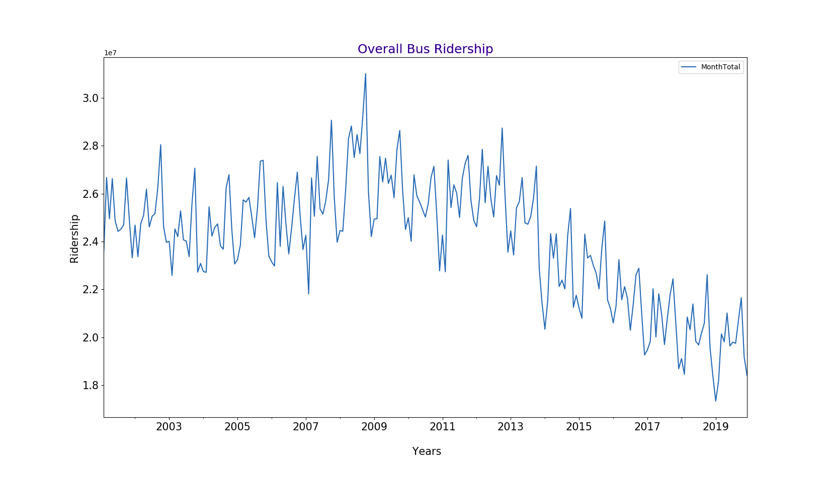
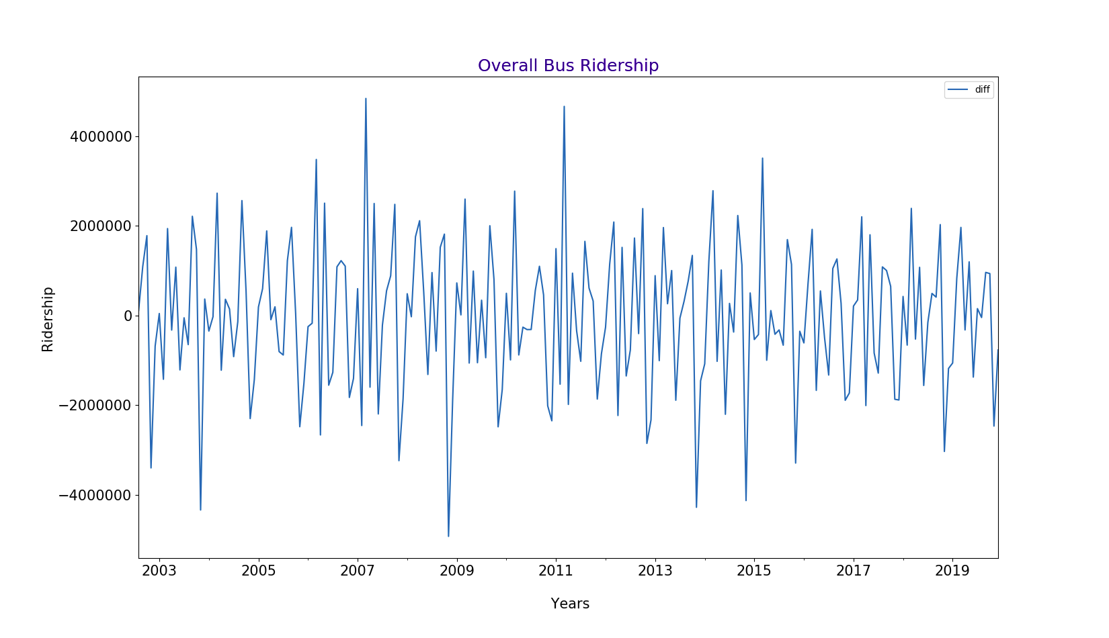
Pre-processing for LSTM
Unstable data
Stable data

Slide 22
Bus Ridership Prediction- LSTM
Parameter tuning:
Added 18 lags which are essentially difference of the difference
Checked our regression coefficient - good
But, set the threshold at .65 in order to predict the ridership value for routes which have higher confidence.
Discarded the prediction for routes which have accuracy less than 80% (Important - CTA keeps changing the routes of buses. This adds noise)

Slide 23
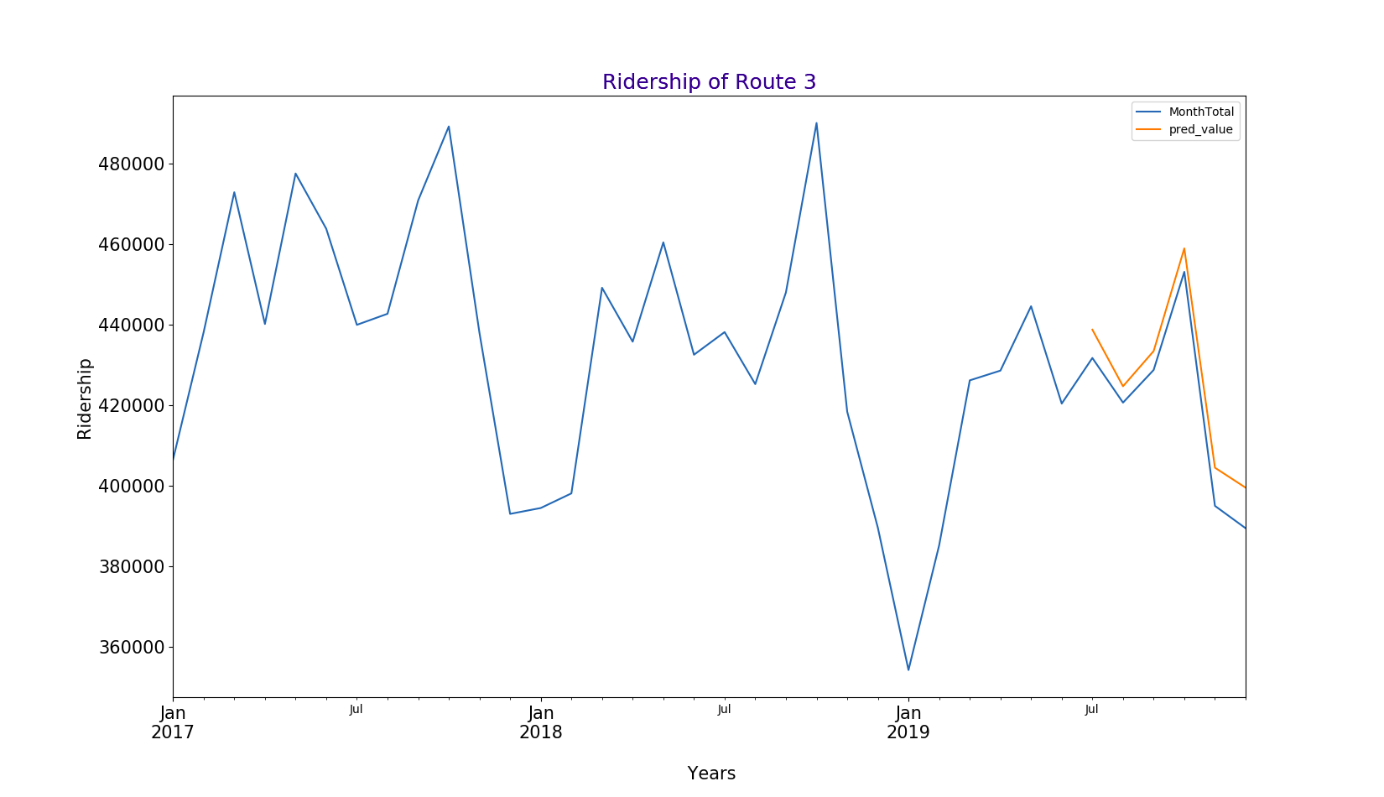
Graphs of ridership prediction for buses - Route 3

Slide 24
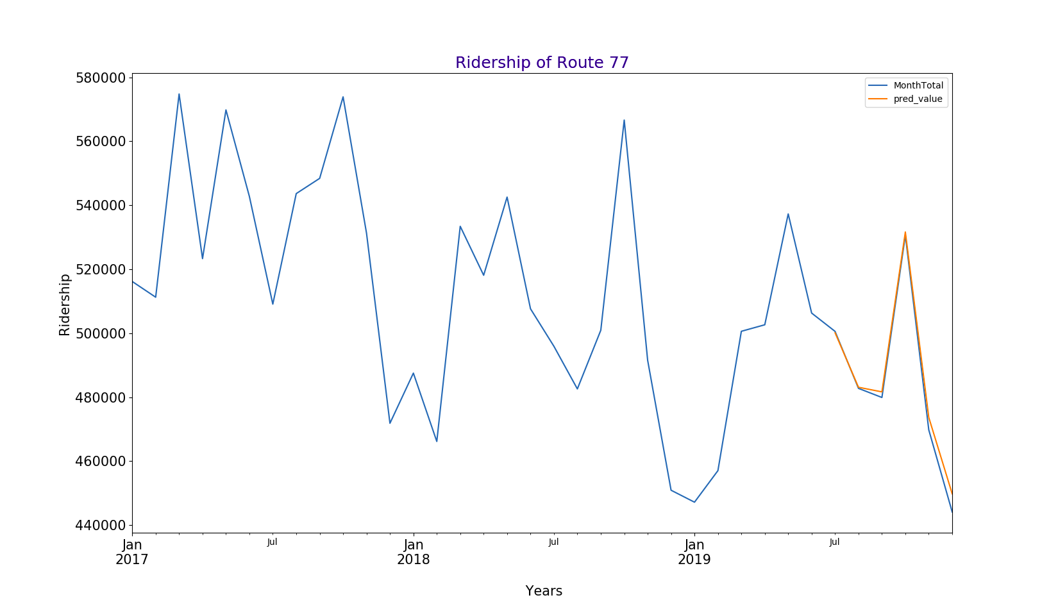
Graphs of ridership prediction for buses - Route 77

Slide 25
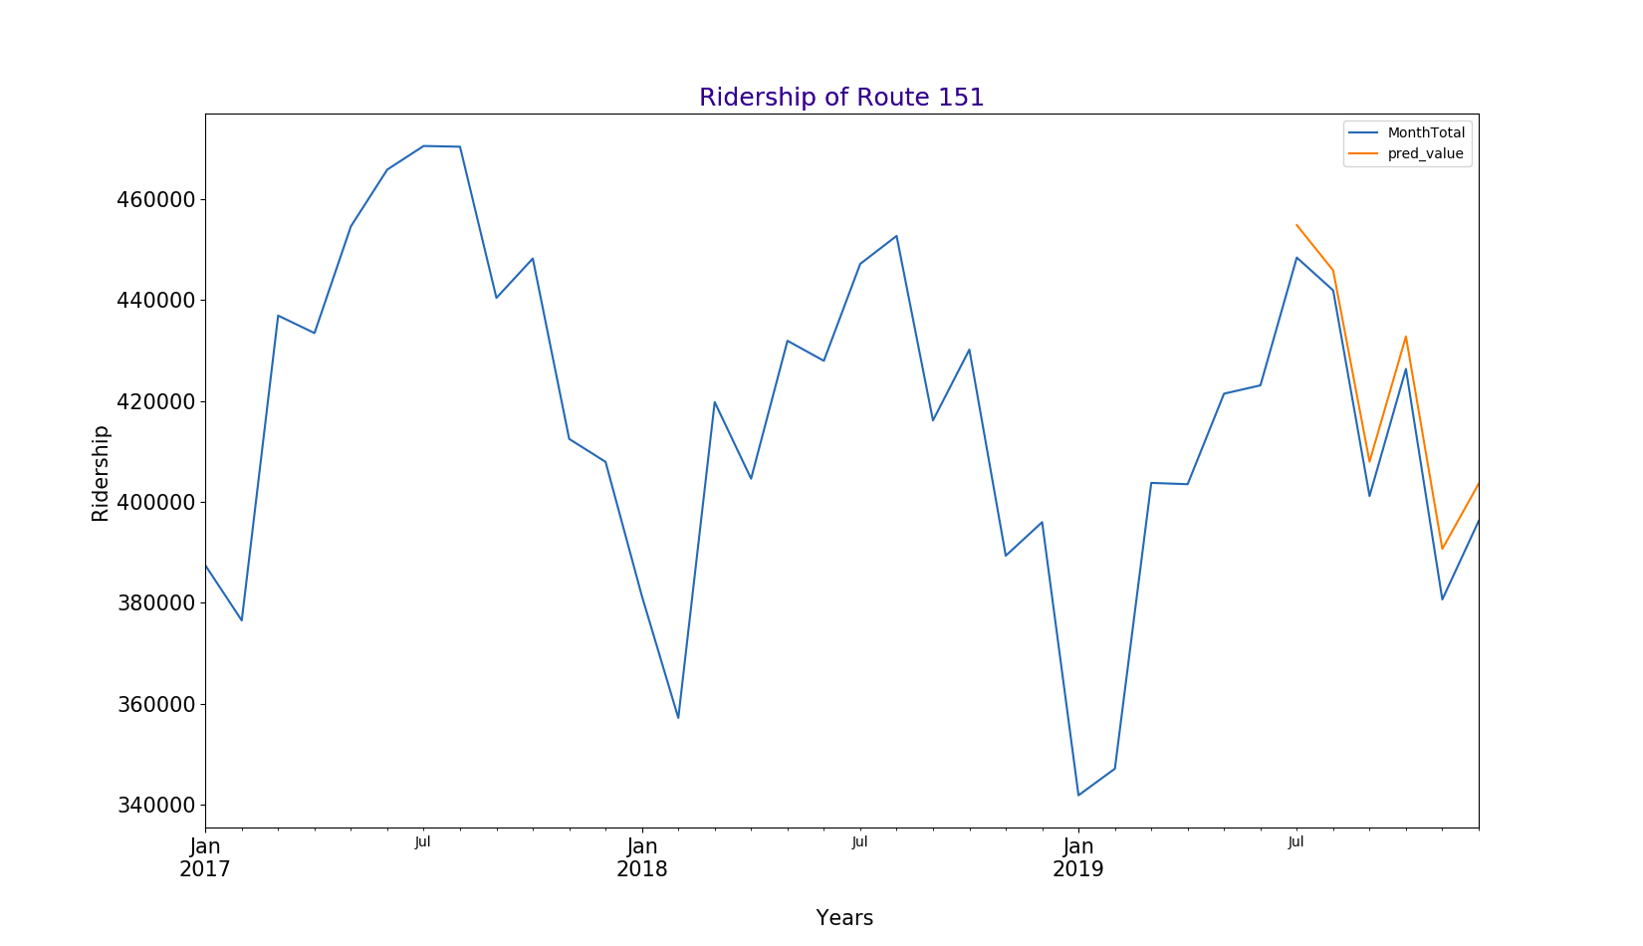
Graphs of ridership prediction for buses - Route 151

Slide 26
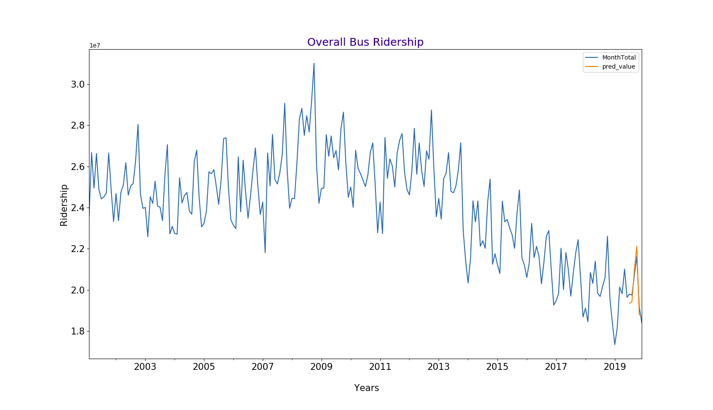
Predicting the total bus ridership for the year 2019

Slide 27
Classifying predicted ridership values into categories
After predicting the bus ridership for each of the buses, we classified the ridership into 5 categories to suggest optimization of bus services to CTA based on these categories. These categories were divided based on normal distribution of the change in ridership values:
Almost same ( 0.9 - 1.1% change)
Slight increase (1.1-1.2 % change)
Heavy increase ( > 1.2 % change)
Slight decrease (0.8-0.9% change)
Heavy decrease ( < 0.8 % change)

Slide 28
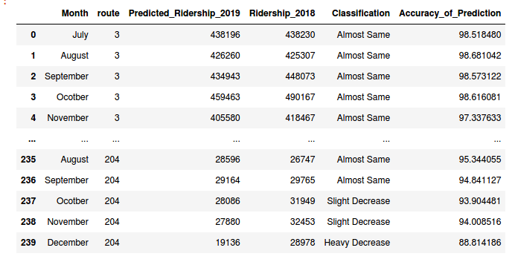
Results
After predicting the ridership values and classifying them into categories, we saved these results in a CSV file.
The final file look like this -

Slide 29
Predicting the ridership of buses and trains using ARIMA
ARIMA: Auto-Regressive Integrated Moving Average
ARIMA allows us to train and tune the model based on it’s 3 hyperparameters (p, d, q)
These hyperparameters tune the seasonality and the trend factor into the model.
Hyperparameters:
p - controls the auto-regressive aspect of the value trend
d - controls the differencing factor between successive values
q - controls the weightage of the moving average

Slide 30
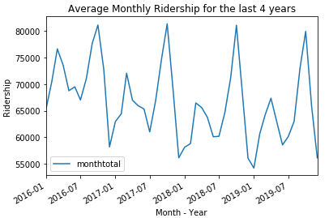
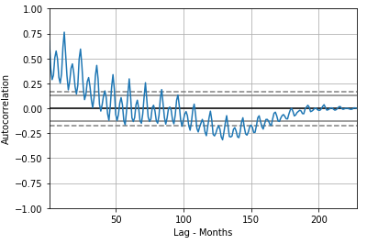
Predicting the ridership of buses and trains using ARIMA
Fig. Shows the yearly trend in ridership for trains
Fig. Auto-correlation between ridership of successive years

Slide 31
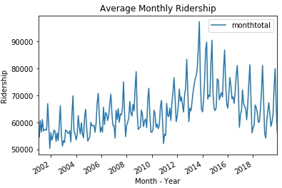
Predicting the ridership of buses and trains using ARIMA
Optimal Hyper-parameters: (p, d, q) = (8, 1, 1)
This means the model performs optimally when consider previous 8 values into our prediction, with single differencing and normal weightage to the moving average.
This can be confirmed by looking at the chart. It does not mean that we only take the previous 8 years of values, but that that taking 8 years of data is sufficient for accurate predictions.

Slide 32
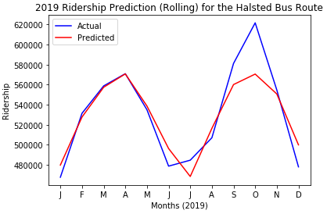
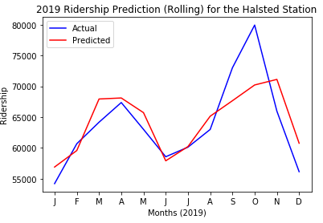
Predicting the ridership of buses and trains using ARIMA
Fig. Rolling predictions for bus dataset
Fig. Rolling predictions for trains dataset

Slide 33
Predicting the ridership of buses and trains using ARIMA
Attained an accuracy of ~95.6% for the buses dataset and an accuracy of ~95.2% for the trains dataset.
Rolling predictions predict values for a given month, and then add this prediction to the dataset to predict the value for the next month. Hence, the error might increase the further into the future we try to predict.
Using these rolling predictions and comparing them to previous ridership values, we can classify which routes and train stations are going to see an increase or decrease in ridership in the following year.
Jefferson Park, LaSalle/Van Buren, Pulaski-Forest Park, Halsted/63rd ← Predicted Decrease in Ridership

Slide 34
Evaluation
We could predict the ridership values with very high accuracy.
Our model performed well on the dataset
Achieved an accuracy of 93.6% for bus ridership prediction using LSTM
Attained an accuracy of ~95.6% for the buses dataset and an accuracy of ~95.2% for the trains dataset using ARIMA
This analysis helps CTA in allocating the optimal amount of resources for each route and station to minimize their costs.

Slide 35
Conclusion
We analyzed the CTA datasets for buses and trains and found out interesting trends and travel patterns
Predicted the ridership for buses and trains with ~95% accuracy
Based on the ridership values, we classified the buses and trains into categories according to change in ridership that is likely to arrive in the future
Objective:
The categories predicting the change in ridership for each bus and train route can:
Help CTA effectively optimize their bus and train rides and infrastructure to accommodate the demands of the commuters and manage their finances effectively.
They can increase or decrease the buses running on routes with heavy increase and decrease in ridership respectively.

Slide 36
Thank You !

